Slide 1
WELCOME
THAPALIYA Bishal ADHIKARI Jyoti

Slide 2
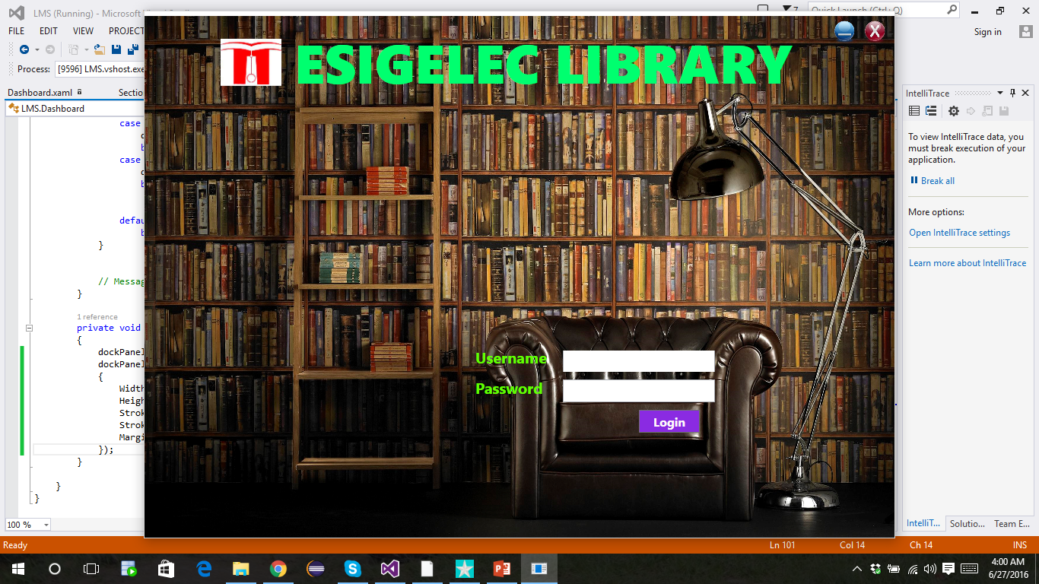

Slide 3

INTRODUCTION
Monitoring and controlling the transactions in a library.
Windows application developed in C# using 4-tier Architecture
- Data Access Layer (DAL),
- Business Access Layer (BAL),
- WCF Services and
- Presentation Layer (WPF).
Notes:
The purpose of Library Management System (LMS) application is monitoring and controlling the transactions in a library.
Library Management System is a windows application will be developed in C# using 4-tier architecture containing Data Access Layer (DAL), Business Access Layer (BAL), WCF Services and Presentation Layer (WPF).

Slide 4
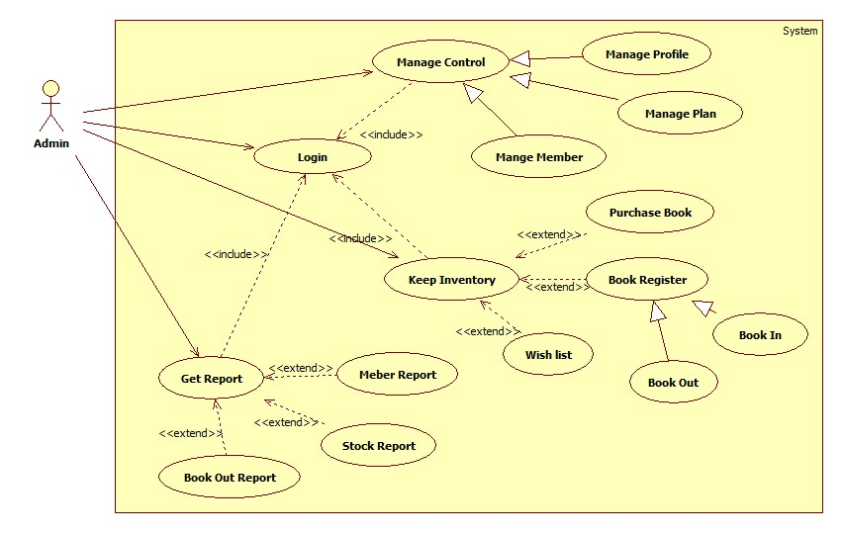
USE CASE DIAGRAM

Slide 5
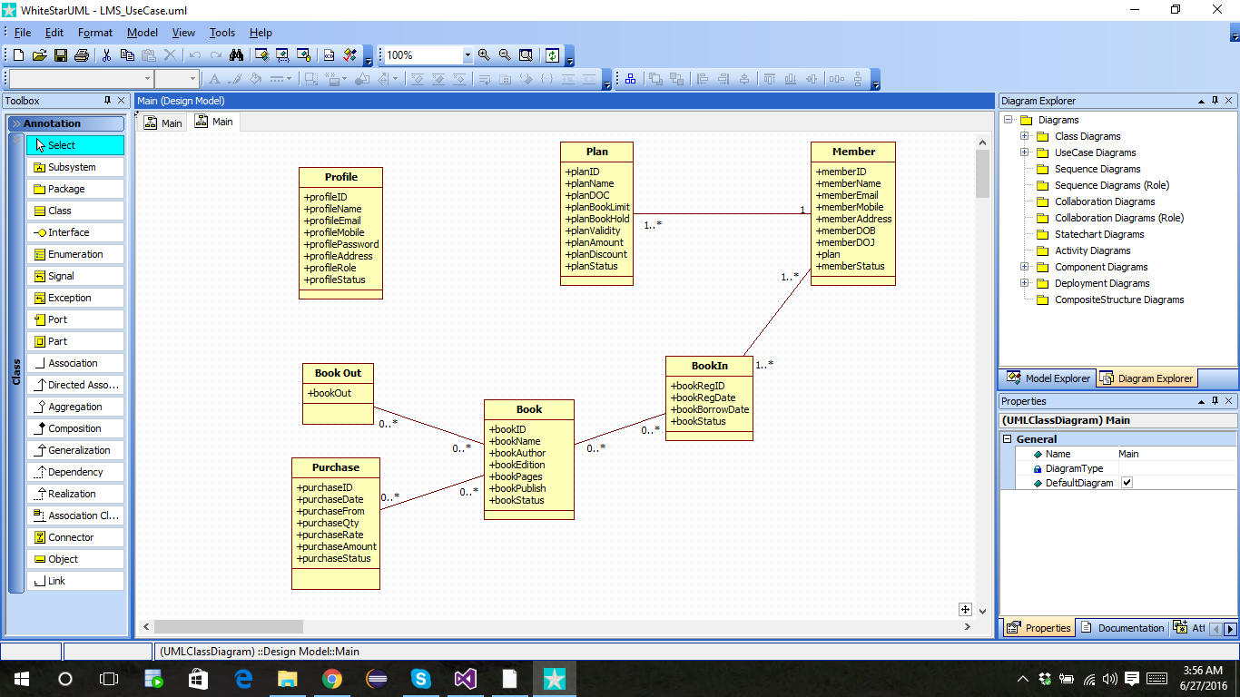
CLASS DIAGRAM

Slide 6
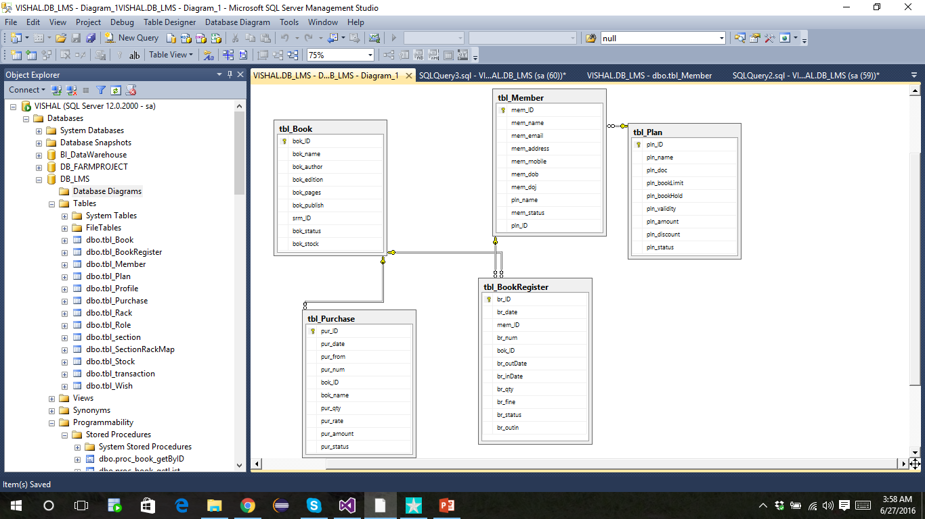
DATABASE DIAGRAM

Slide 7
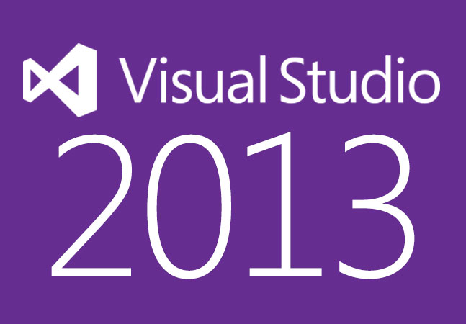
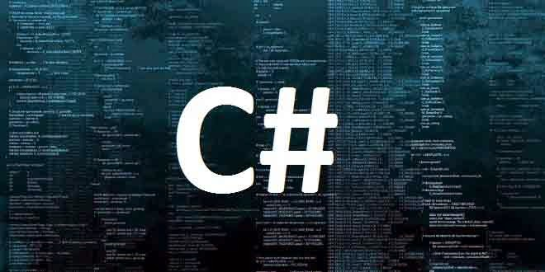
TECHNOLOGIES USED
Microsoft Visual Studio 2013
An IDE, used to develop computer programs for Microsoft Windows, as well as web sites, web applications and web services.
C# Programming Language
C# is one of the programming languages designed for the Common Language Infrastructure.

Slide 8

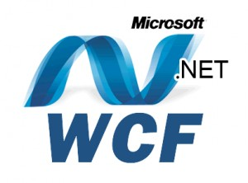

TECHNOLOGIES USED
Windows Presentation Foundation (WPF)
A graphical subsystem for rendering user interfaces in Windows-based applications by Microsoft.
Windows Communication Foundation (WCF)
A framework for building service-oriented applications.
MSSQL Server
A relational database management system developed by Microsoft.

Slide 9
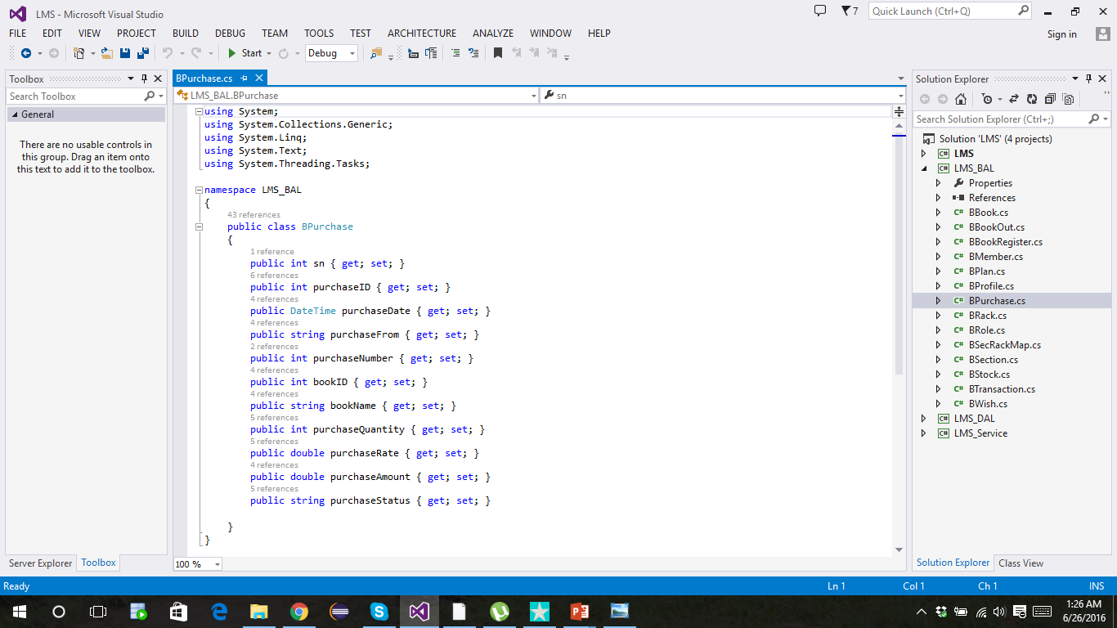
CODES
Business Access Layer (BAL)

Slide 10
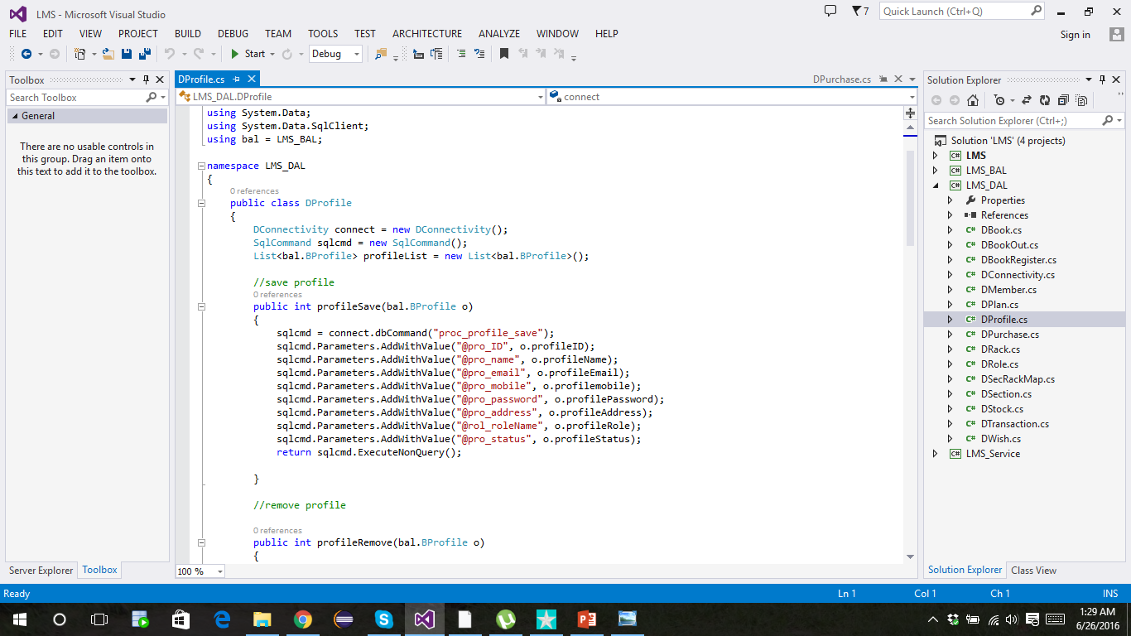
CODES
DATA Access Layer (DAL)

Slide 11
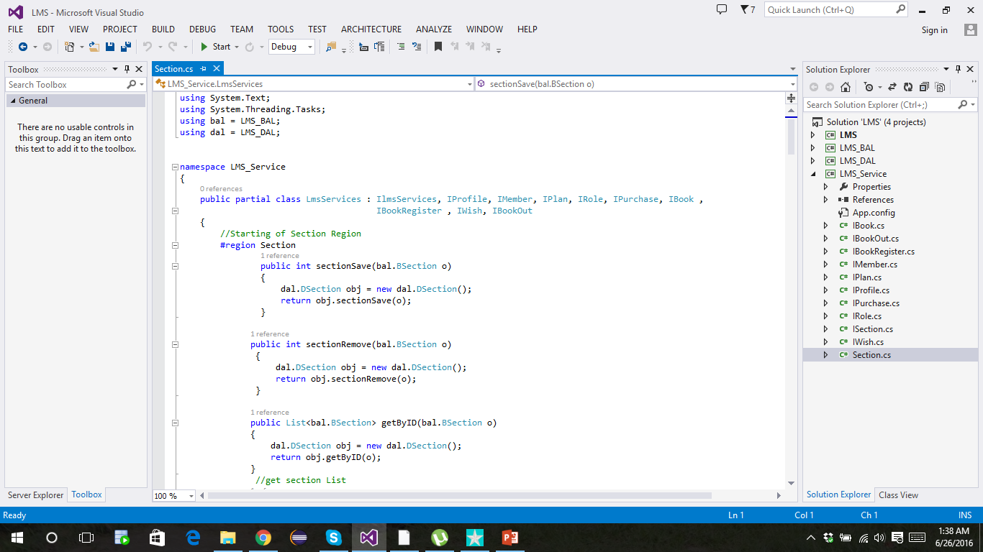
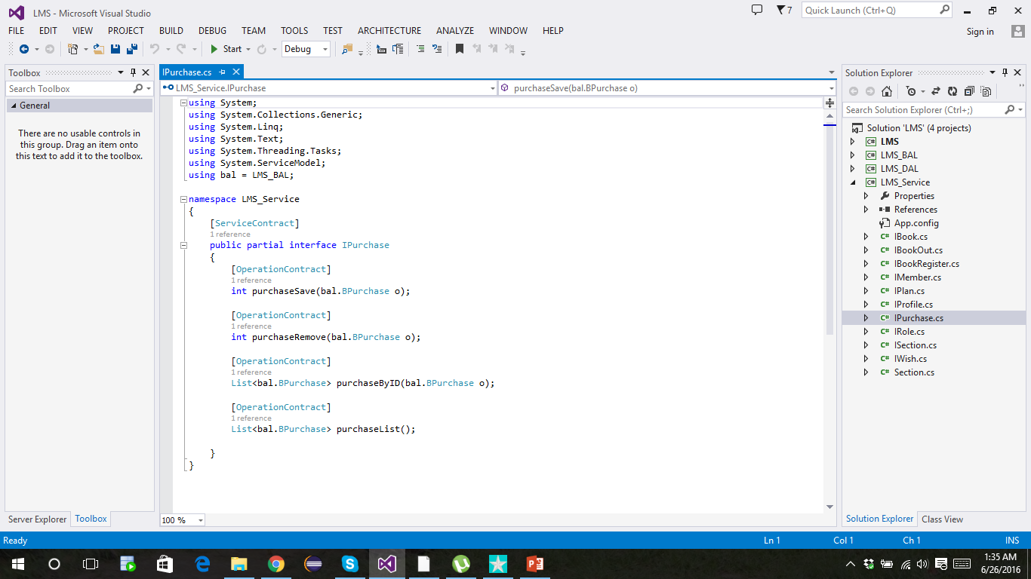
CODES
Windows Communication Foundation (WCF)

Slide 12
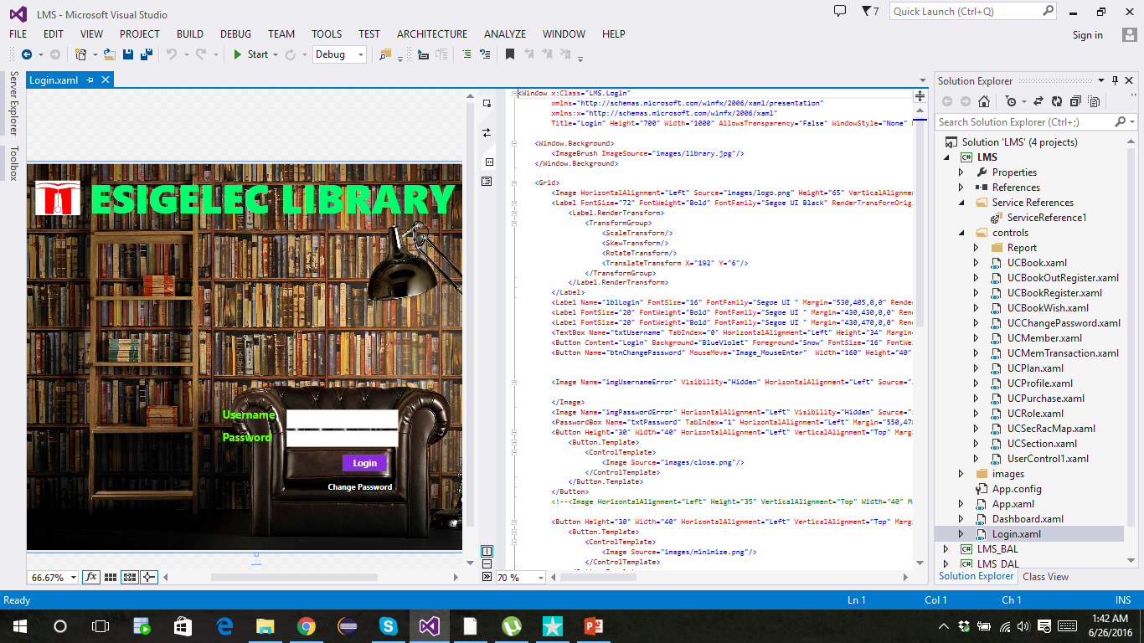
CODES
Windows Presentation Foundation (WPF)

Slide 13
DEMO

Slide 14

THANK
YOU

